Slide 1
What is association mining
Association mining aims to extract interesting correlations, frequent patterns, associations or casual structures among set of items or objects
Widely used in various areas such as telecommunication network, market and risk management, inventory control, cross marketing, catalog design etc
Association rule mining is used to discover relationships between items in a dataset. An association rule is a statement of the form "If A, then B," where A and B are sets of items. The strength of an association rule is measured using two measures: support and confidence. Support measures the frequency of the occurrence of the items in the rule, and confidence measures the reliability of the rule.

Slide 2
Association Rule Mining
Given a set of transactions, find rules that will predict the occurrence of an item based on the occurrences of other items in the transaction
Association is used to mine frequent patterns
Frequent patterns can be
Frequent item sets (e.g. milk and bread)
Frequent Subsequences (e.g. buying first a pc, then a digital camera and a memory card)

Slide 3
Association Rule: frequent item set
Given database of transactions, each transaction is a list of items
Find all rules that correlate the presence of one set of items with that of another set of items
e.g. 98% of people who purchase tires and auto accessories also get automotive services done
e.g. Market basket analysis

Slide 4
Market basket analysis
“Which groups or sets of items are customers likely to purchase on a given trip to the store?”
This process analyzes customer buying habits by finding associations between the different items that customers place in their “shopping baskets”
It helps retailers develop marketing strategies by gaining insight into which items are frequently purchased together by customers

Slide 5
Market basket analysis
The result can be used in
-Making various marketing strategies or advertising strategies
-Shelf arrangement
-design different layouts of shop
-Can lead to increased sales
These patterns can be represented in the form of association rules.
“Body=>Head[support, confidence]”
A=>B where A and B belong to different item sets
E.g. if customer purchase computers also tends to buy antivirus software at the same time
buys(x, ”computers”)=>buys(x, antivirus s/w)[support=2%,confidence=60%]

Slide 6
Measures of association (rules)
1.Support: What % of total transactions in a database have this pattern
A support of 2% means that 2% of all transactions under analysis show that computer and antivirus software are purchased together
2.Confidence: How many times this pattern has occurred if first has occurred
A confidence of 60% means that 60% of customers who purchased a computer also bought the software
Association rules must satisfy a minimum support threshold and a minimum confidence threshold (called strong)
Such threshold can be set by users or domain experts

Slide 7
Measures of association (rules)
Let each transaction T has a set of items .
X, Y are a set of items contained in T
Support (s): Fraction of transactions that contain both X and Y
Support(X=>Y)=P(XUY)=support_count(XUY)/T
where probability P, union of set X and Y or say both X and Y
Confidence (c): Measures how often items in Y appear in transactions that contain X
confidence(X=>Y)=support_count(XUY)/support_count(X)
where support count (σ) is occurrence frequency of an itemset
Frequent Itemset:
An itemset whose support is greater than or equal to a minsup threshold

Slide 8
Example of Association Rules Market-Basket transactions
Support (S)
Support count (σ)
σ({Milk, Bread, Diaper}) = 2
Confidence (C)

Slide 9
Example of Association Rules
Example of Rules:
{Milk,Diaper} → {Beer} (s=0.4, c=0.67) {Milk,Beer} → {Diaper} (s=0.4, c=1.0)
{Diaper,Beer} → {Milk} (s=0.4, c=0.67)
{Beer} → {Milk,Diaper} (s=0.4, c=0.67) {Diaper} → {Milk,Beer} (s=0.4, c=0.5)
{Milk} → {Diaper,Beer} (s=0.4, c=0.5)
Observations:
All the above rules are binary partitions of the same itemset: {Milk, Diaper, Beer}
Rules originating from the same itemset have identical support but can have different confidence
Thus, we may decouple the support and confidence requirements

Slide 10
Association Rule Mining Task
Given a set of transactions T, the goal of association rule mining is to find all rules having
support ≥ minsup threshold
confidence ≥ minconf threshold
Two-step approach:
Find Frequent Itemset
Generate all itemsets whose support ≥ minsup
Generate strong association rules
rules must satisfy minimum support and minimum confidence

Slide 11
Find frequent itemsets
Two Approaches
1.Apriori Algorithm(using candidate generation)
Apriori property: All the subsets of a frequent itemset must also be frequent
2.Frequent Pattern -Growth Algorithm

Slide 12
Apriori Algorithm: Find frequent itemsets using candidate generation
Step 1: The set of frequent item set is found by scanning database to identify the count for each item (C1)and collecting those items that satisfy minimum support (L1)
join step: Generate all possible candidate itemsets C_{k} of length k
prune step: Remove those candidates in C_{k} that cannot be frequent. (less than min_support count)
Step 2: L1 is used to find set of frequent Itemset L2 which is used to find L3 and so on, untill no more frequent itemset K can be found.

Slide 13
Apriori algorithm in pseudocode
Join Step: C k is generated by joining Lk-1with itself
• Prune Step: Any (k-1)-itemset that is not frequent cannot be a subset of a frequent k-itemset
Pseudo-code: C k: Candidate itemset of size k L k : frequent itemset of size kL₁= {find frequent itemset(D)};
for (k= 2; L_{k-1} !=∅; k++) do begin
C_{k}= (joining)candidates generated from L_{k-1}
(L_{k-1 join} L_{k-1} )
and (pruning) eliminating any k-1 size itemset that is not frequent
for each transaction t in database do
increment the count of all candidates in
C_{k} that are contained in t
L_{k} = count of candidates in C_{k} >= min_sup
end
return L=∪_{k} L_{k};

Slide 14
Generating Association rules from Frequent Itemsets
Once frequent itemsets from transactions have been found, it is easy to generate strong association rules from them.
Where Strong association rules satisfy both minimum support and minimum confidence
Association rules can be generated as follows:
1.For each frequent itemset l, generate all nonempty subsets of l
2.For every subset s of l, output rule “s=>(l-s)” if
support_count(l)/support_count(s)>=min_conf
Where min_conf is the minimum confidence threshold

Slide 15
Generating rules: an example
Suppose {2,3,4} is frequent, with sup_count=50%
Proper nonempty subsets: {2,3}, {2,4}, {3,4}, {2}, {3}, {4}, with sup_count=50%, 50%, 75%, 75%, 75%, 75% respectively
Let min confidence=50%
Confidence=support_count(X,Y)/support_count(X)
2. Resulting association rules are generated :
2,3 → 4, confidence=50/50=100%
2,4 → 3, confidence=50/50=100%
3,4 → 2, confidence=50/75=67%
2 → 3,4, confidence=50/75=67%
3 → 2,4, confidence=50/75=67%
4 → 2,3, confidence=50/75=67%
All rules have confidence> 50%, so these are strong association rules

Slide 16
Example 1 : Transactional dataset D
Please refer (class notes) problem solved in the classroom for detailed steps and solution or book Kamber (page no 250)

Slide 17
Example 1 : Transactional dataset D
min support count=2
C1
L1
C2
L2
C3
L3
Since we have only one itemset in C3, the apriori algorithm terminates and we get frequent item set {2, 3, 5} WITH MIN SUPPORT COUNT=2

Slide 18
Example 1 : Transactional dataset D
Step-2: Represent pair of 1-items with MIN support count=2 or 50%
1-Item set TiD | Support
1
2
3
4
5
Total transactions =4
Notes:
Please refer (class notes) problem solved in the classroom for detailed steps and solution or book Kamber (page no 250)

Slide 19
Example 1 : Transactional dataset D
Step-2: Represent pair of 2-items with MIN support count=2 or 50%
2-Item set TiD | Support
Item Set: 1,2,3,5
Eliminate item with <50% support
Total transactions =4

Slide 20
Example 1 : Transactional dataset D
Step-3: Represent pair of 3-items with MIN support count=2 or 50%
Item Set: 1,2,3,5
Eliminate pairs with <50 support
3-Item set TiD | Support
Total transactions =4

Slide 21
Example 1 : Transactional dataset D
Step-4: Association rule generation Rule with MIN support count=2 or 50% Confidence = 70%
Rules | Support | Confidence
Final Item Set: 2,3,5
compare with confidence 70%
Confidence = support count(X,Y)
--------------------------
Support count(X)

Slide 22
Example 1 : Transactional dataset D
Step-2: Represent pair of items with MIN support count=2 or 50% Confidence = 70%
Rules | Support | Confidence
Final Item Set: 2,3,5
compare with confidence 70%
Confidence = support count(X,Y)
--------------------------
Support count(X)

Slide 23
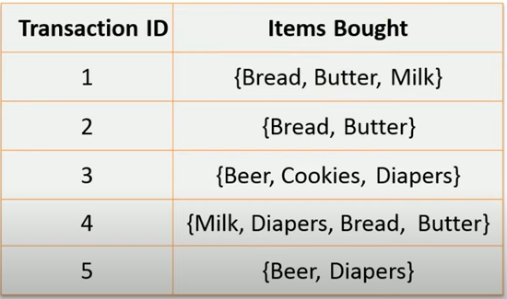
Apriori algorithm Example-2
Minimum support = 40% or 2 Minimum Confidence = 70%

Slide 24
Apriori algorithm Example-2
Minimum support = 40% or 2 Minimum Confidence = 70%
1-Item set | Support count
Step- 1 Item

Slide 25
Apriori algorithm Example-2
Minimum support = 40% or 2 Minimum Confidence = 70%
Step-2 Item
2-Item set | Support count

Slide 26
Apriori algorithm Example-2
Minimum support = 40% or 2 Minimum Confidence = 70%
Step-3 Item
3-Item set | Support count

Slide 27
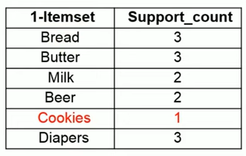
Apriori algorithm Example-2
Step1: Represent distinct items in dataset
Minimum support = 40% Minimum Confidence = 70%

Slide 28
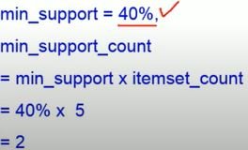
Apriori algorithm Example-2
Step1: Represent distinct items in dataset
Minimum support = 40% Minimum Confidence = 70%

Slide 29
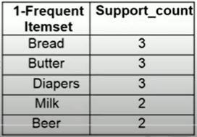
Apriori algorithm Example-2
Step1: Represent distinct items in dataset
Minimum support = 40% Minimum Confidence = 70%
Bread, Butter, milk, Diapers, Beer

Slide 30
Apriori algorithm Example-2
Step 2: Form item pair
Minimum support = 40% Minimum Confidence = 70%
2-Item set | Support_count
Bread, Butter, milk, Diapers, Beer

Slide 31
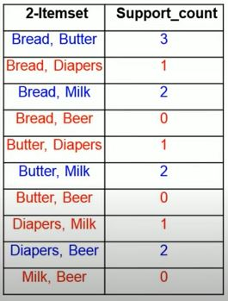
Apriori algorithm Example-2
Step 2: Form item pair
Minimum support = 40% or 2 i.e 2 Minimum Confidence = 70%
Bread, Butter, milk, Diapers, Beer

Slide 32
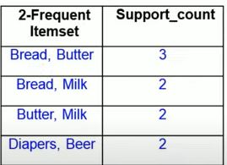
Apriori algorithm Example-2
Step 2: Form item pair
Minimum support = 40% i.e 2 Minimum Confidence = 70%
Bread, Butter, milk, Diapers, Beer

Slide 33
Apriori algorithm Example-2
Step 3: Form 3item pair
Minimum support = 40% i.e 2 Minimum Confidence = 70%
Bread, Butter, milk, Diapers, Beer
3-Item set | Support_count

Slide 34
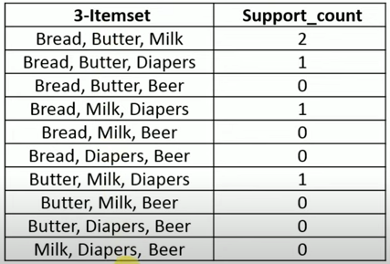
Apriori algorithm Example-2
Step 2: Form item pair
Minimum support = 40% i.e 2 Minimum Confidence = 70%
Bread, Butter, milk, Diapers, Beer

Slide 35

Apriori algorithm Example-2
Step 2: Form item pair
Minimum support = 40% i.e 2 Minimum Confidence = 70%
Bread, Butter, milk, Diapers, Beer

Slide 36
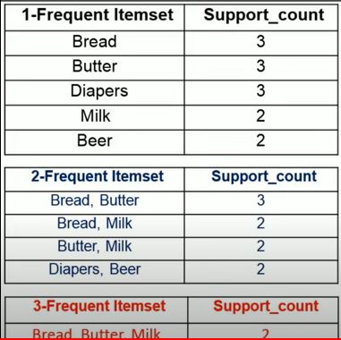
Apriori algorithm Example-2
Step 3: Association Rules and select srong association rules
among them based on confidence
Minimum support = 40% i.e 2 Minimum Confidence = 70%

Slide 37
Apriori algorithm Example-2
Step 3: Association Rules and select srong association rules
among them based on confidence
Minimum support = 40% i.e 2 Minimum Confidence = 70%
Rule | Support | Confidence

Slide 38
Assignments
Q. 3 Find frequent itemset and generate strong association rules with min support=40% and minimum threshold confidence=60%.
min support count=(min_supp%X T)/100
min support count=3

Slide 39
Apriori algorithm Example-4
Q4 . Find frequent itemset and generate strong association rules with min support count=2 and minimum threshold confidence=70%.

Slide 40
Apriori algorithm Example-4
Q4 . Find frequent itemset and generate strong association rules with min support count=2 or 2/9=22% and minimum threshold confidence=70%.
Items | Support count

Slide 41
Apriori algorithm Example-4
Methods To Improve Apriori's Efficiency
Hash-based itemset counting: A k-itemset whose corresponding hashing bucket count is below the threshold cannot be frequent.
Transaction reduction: A transaction that does not contain any frequent k-itemset is useless in subsequent scans.
Partitioning: An itemset that is potentially frequent in DB must be frequent in at least one of the partitions of DB.
Sampling: Mining on a subset of given data, lower support threshold and a method to determine completeness.
Dynamic itemset counting: Add new candidate itemsets only when all of their subsets are estimated to be frequent.

Slide 42
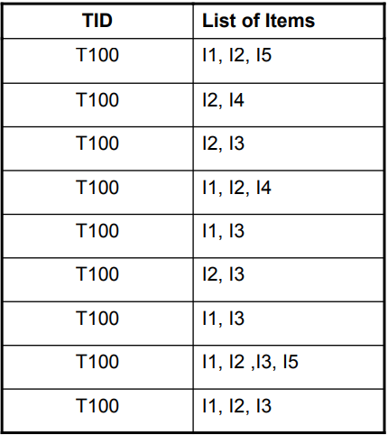
FP-Growth Method : An Example
min_sup = 2/9 = 22 % )
The first scan of database is same as Apriori, which derives
the set of 1-itemsets & their support counts.
The resulting set is denoted as L = {I2:7, I1:6, I3:6, I4:2, I5:2}

Slide 43
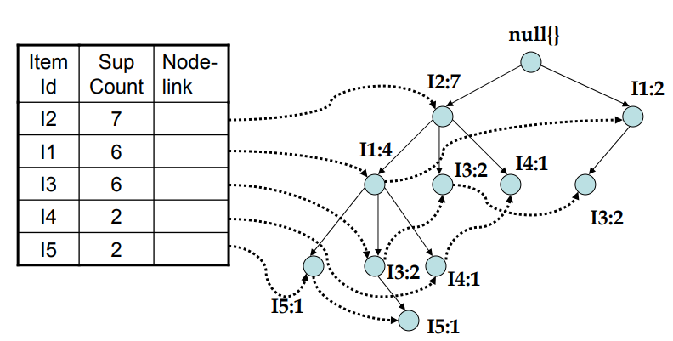
FP-Growth Method : An Example

Slide 44
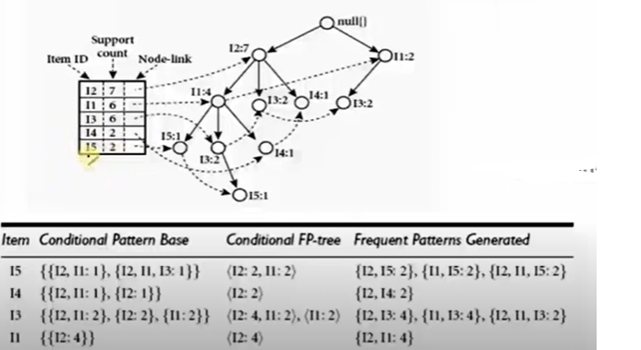
FP-Growth Method : An Example

Slide 45
Multilevel Association Rule in data mining
Multilevel Association Rule mining is a technique that extends Association Rule mining to discover relationships between items at different levels of granularity.
Multilevel Association Rule mining can be classified into two types:
multi-dimensional Association Rule and multi-level Association Rule.
Multi-dimensional Association Rule mining
This is used to find relationships between items in different dimensions of a dataset. For example, in a sales dataset, multi-dimensional Association Rule mining can be used to find relationships between products, regions, and time.
Multi-level Association Rule mining
This is used to find relationships between items at different levels of granularity. For example, in a retail dataset, multi-level Association Rule mining can be used to find relationships between individual items and categories of items.

Slide 46
Multilevel Association Rule in data mining
Needs of Multidimensional Rule
Multidimensional rule mining is important because data at lower levels may not exhibit any meaningful patterns, yet it can contain valuable insights. The goal is to find such hidden information within and across levels of abstraction

Slide 47
Apriori algorithm Example-3
Q.3 Find frequent itemset for the given dataset. Min support =40%
min support count=support percent*no of transactions/100
min support count=40*5/100=2
Tid | A | B | C | D | E
T1 | 1 | 1 | 1 | 0 | 0
T2 | 1 | 1 | 1 | 1 | 1
T3 | 1 | 0 | 1 | 1 | 0
T4 | 1 | 0 | 1 | 1 | 1
T5 | 1 | 1 | 1 | 1 | 0

Slide 48
Disclaimer
disclaimer: Content of this presentation is not original and it has been prepared from various sources for teaching purposes.
Please refer (class notes) problem solved in the classroom for detailed steps and solution or book Kamber (page no 250)
Thank you

